Slide 1
Welcome Back Parents and students
2021 – 2022 School Year

Slide 2
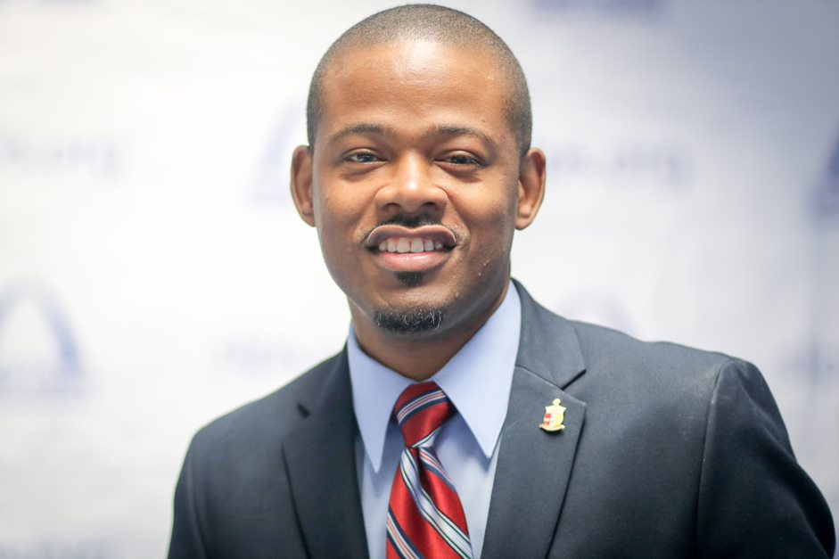
Meet the principal
Jim Triplett, Principal
“Let’s Heal! Let’s Read! Let’s Succeed!

Slide 3
Meet the teacher(s)
Nicole Entzeroth (ms. E). I am so thrilled to work with, know deeply, challenge, and celebrate with your child this year. Please contact me (and expect to be contacted by me! ☺) for anything!
636-448-1709; Nicole.Entzeroth@slps.org
2nd year at Froebel, taught 1st and 2nd grade virtually last year
Related arts: Mr. Nusser (Gym), Mr. Reed (Art), Mr. Kilpatrick (Music), mrs. White (librarian)
Sped team: Ms. Horton, Ms. Arleen Thomas, Mr. Stockard, ms. Simms (speech)
Family services and counseling: Mrs. Buwalda, Mr. cato, ms. costello

Slide 4
Family and community specialist
My name is Patricia Costello, I want to Welcome our families to the 2021 – 2022 school year here at Froebel Literacy Academy. I am looking forward to serving our families, sharing resourceful information and encouraging your parental involvement at our academy. I can be reached by phone: (314) 771-3533 or email: Patricia.Costello@slps.org
“In order to understand our present and ensure our future, we must know our past.”

Slide 5
Welcome Froebel Eagles My name is Jenny Buwalda and I am the School Social Worker at Froebel Literacy Academy. I am in the office on Mondays, Thursdays and Fridays and will always be available through email. If you are in need of any additional resources, please contact me. I look forward to meeting all of you during the upcoming 2021-2022 school year.
Jenny Buwalda
Jennifer.Buwalda@slps.org
314-771-3533

Slide 6
Microsoft Teams
Please refer to your technology packet for instructions
For additional questions, please contact our school secretary ms. As-siyeed at 314-771-3533
Microsoft teams will not be used unless we move to virtual learning. your child will join “ms. E’s 2nd grade class”

Slide 7
Microsoft teams
This is the camera button. When you see a line through the camera, your video is off. When you click on the camera button, the line will disappear, and your camera will be on.
This is the sound button. It is a picture of a microphone. When you click on this button, a line will appear across the microphone. When you see the line through it, you are on mute, and no one can hear you.
When you click on this icon again, the line will disappear, and your microphone will be on, allowing everyone to hear you.

Slide 8
Daily Schedule
Student Drop-off at 9, door 2 (door directly across from door 4, near gym)
Your child will receive a welcome packet with more information on our classroom routines and procedures, daily schedule, etc.

Slide 9
learning – lessons with the teacher
Learning includes:
Live Lessons – whole class
Guided Reading – small, leveled reading groups
Small Groups – groups of students who need help with a certain topic or skill
Story Time – a story read aloud by the teacher

Slide 10
Independent work
Independent work – Class Assignments
Independent Reading
Homework

Slide 11
reading
New myview curriculum for whole class and small group instruction
Begins 2nd week of school

Slide 12
math
Same curriculum as last year
Students will participate in whole group and small group instruction
Manipulatives and multiple means of expression

Slide 13
Related arts

Slide 14
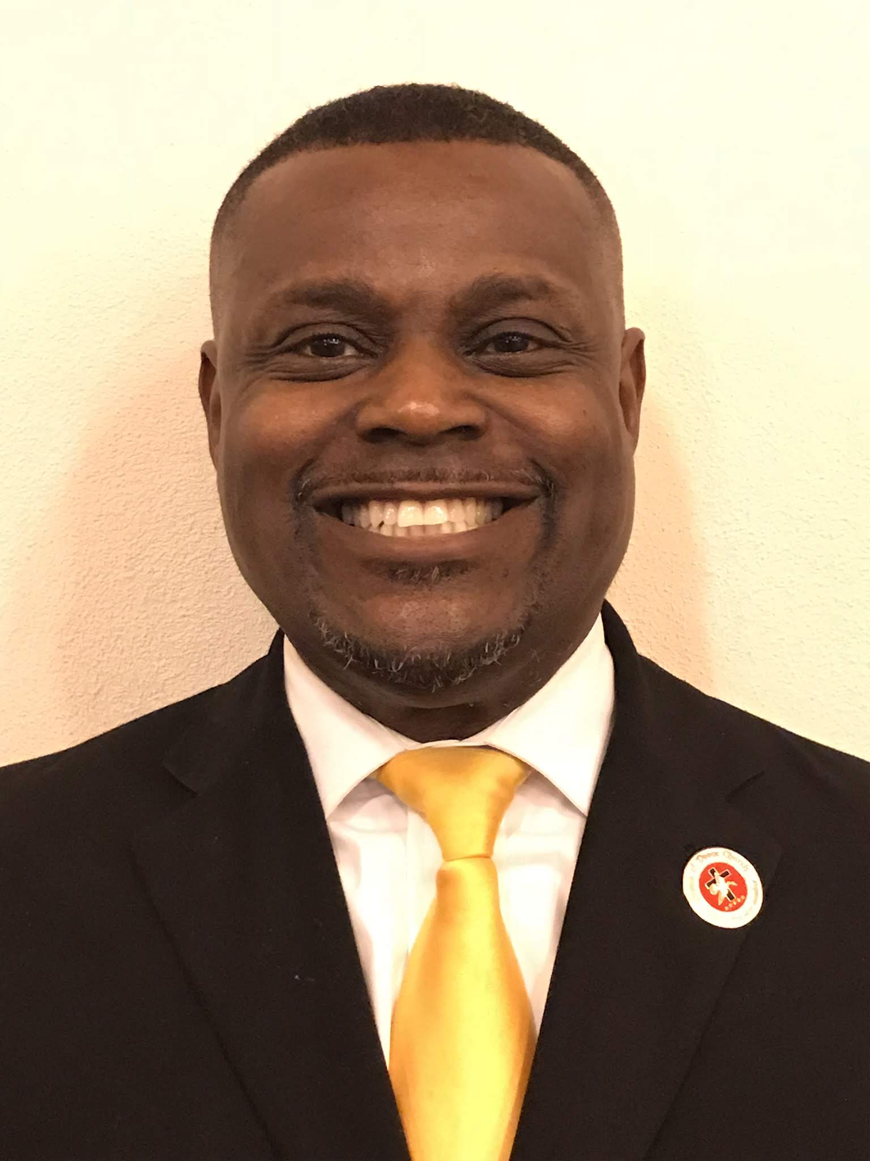
Meet the music teacher
Greetings Parents
My name is Mr. Kilpatrick and I am the new music teacher for the 2021-22 school. I am excited about every child learning musical concepts and how to perform musically in public forums. I will make sure that we have a diversified program where every child can succeed musically based on their abilities and cultural background.

Slide 15
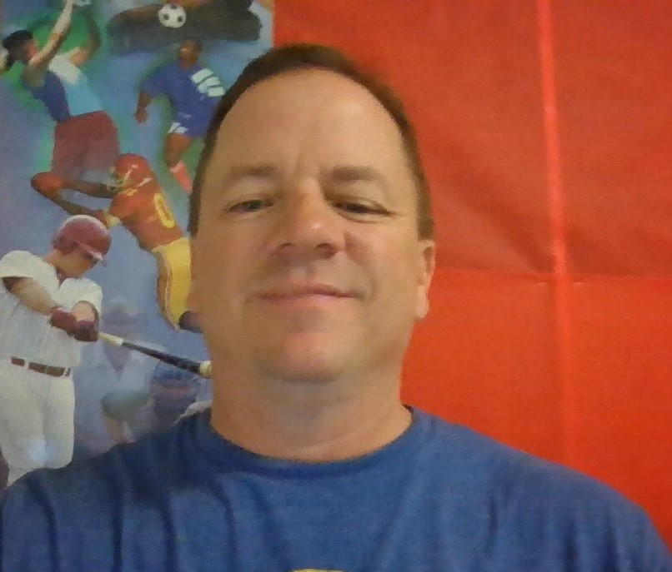
Physical Education
Mr. Nusser
Bachelor of Science in Physical Education from Missouri State University.
This will be my 24th year at Froebel.
Grew up in Toledo, Ohio.
Married with 4 kids ages 18, 17, 15 & 13.
Pets; Fish.

Slide 16
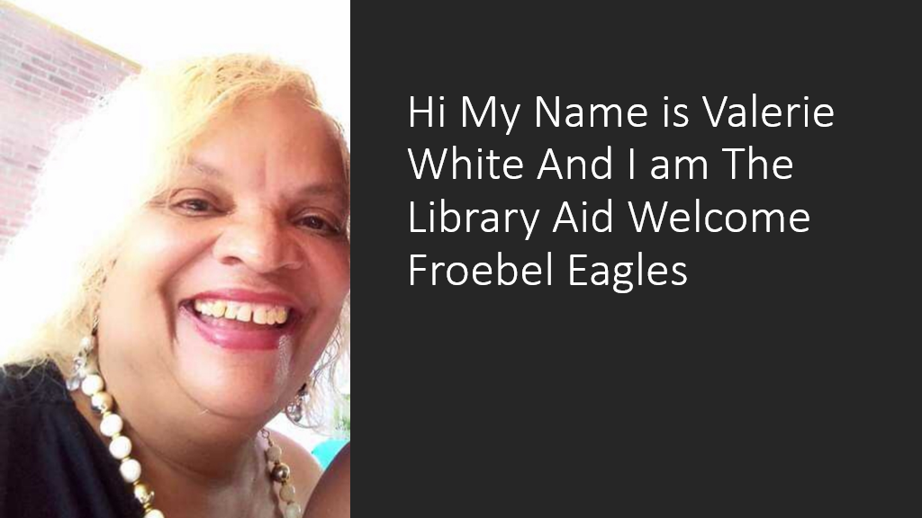

Slide 17
Breaks/Lunch/Recess
Transitions: built into schedule, full class bathroom breaks
Regular movement breaks during class time
Lunch: ms. E will bring students to cafeteria, students will eat lunch in classroom
Recess: ms. E will take students to recess. Masks not required outside.

Slide 18
Covid-19 guidelines
Ms. E will refer to covid-19 protocol packet received first week of professional development for teachers (printed powerpoint)

Slide 19
Supplies and Books
You should have received all of the technology and information that your child will need for learning.
Please contact the school if you are missing something.

Slide 20
Online educational websites
STAR – test to determine reading and math level
Class Dojo – communication tool
Savvas – ms. E will provide students with their login information and add apps to students’ home screens. Correlates directly with ela and math curriculum.

Slide 21
Who to contact with problems
Ms. e: 636-448-1709
Mr. triplett (Principal): 314-934-4909
Froebel: 314-771-3533

Slide 22
Important dates and times
The first day of school is Monday, August 23rd .
Please make sure that your child is at school each day by 9:00.
The school day ends at 4:17 pm each day. Dismissal will begin at 4:10 p.m.

Slide 23
We’ve got this!
REMEMBER – this is new for all of us. Be patient and kind with each other. We will figure this out together. Most importantly – don’t panic! We are here to help.
Your child’s education and social/emotional growth is the most important thing to us right now.
Together, we will ensure that your child will continue to learn at high levels.

Slide 24
Questions?

